Slide 1
Capstone 3 – Stock price prediction
In this project, the stock price of three Nasdaq listed companies was analyzed.
6 models and various scenarios were considered:
AR
MA
ARIMA
dummy Regressor – mean strategy
Random Forest
Decision Tree

Slide 2
Capstone 3 – Stock price prediction
The three companies analysed are:
OCUL Therapeutics, sticker symbol OCUL
Solid Biosciences, sticker symbol SLDB
Urogen Pharma, sticker symbol URGN

Slide 3
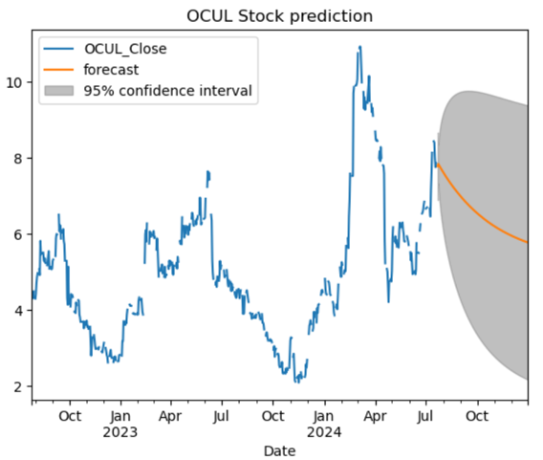
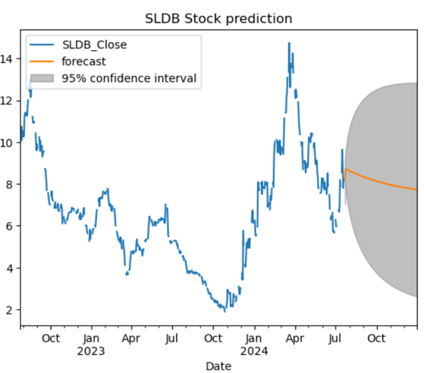
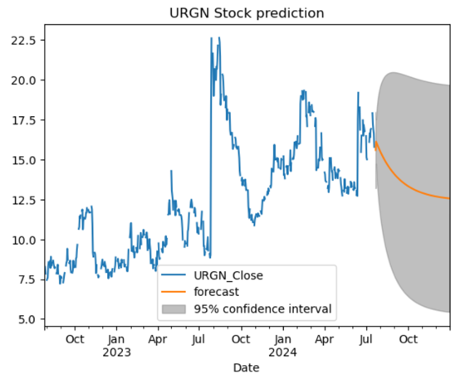
Capstone 3 – AR model forecasting

Slide 4
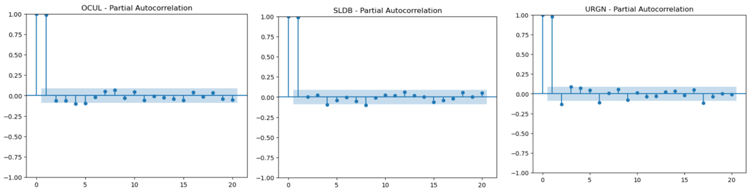
Capstone 3 – Choosing the right model The Partial Autocorrelation Function PACF PACF measures the incremental benefit of adding another lag. The more parameters in a model, the better the model will fit the data. But this can lead to overfitting of the data.
-for an AR(1) model, only the lag-1 PACF is significantly different from zero.
-the number of significant lags for the PACF indicate the order of the AR model, in this case 1

Slide 5
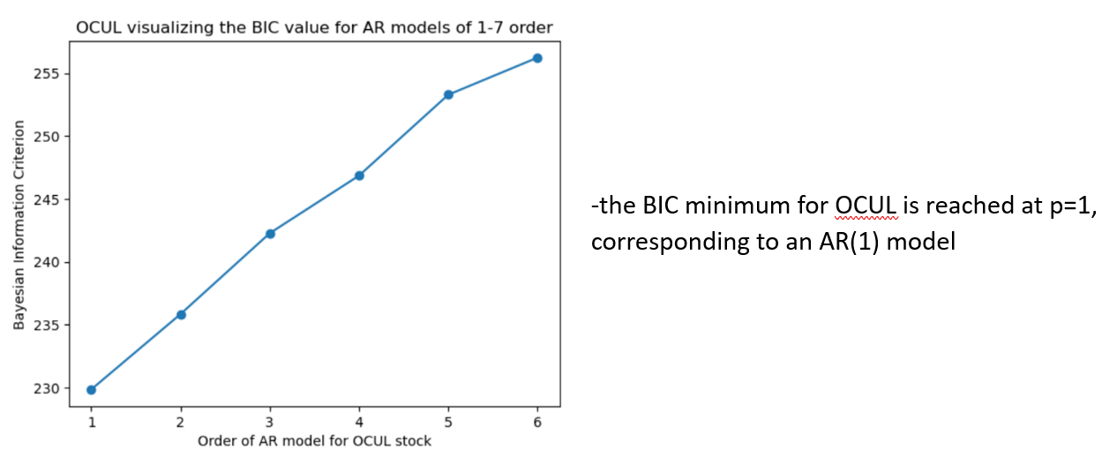
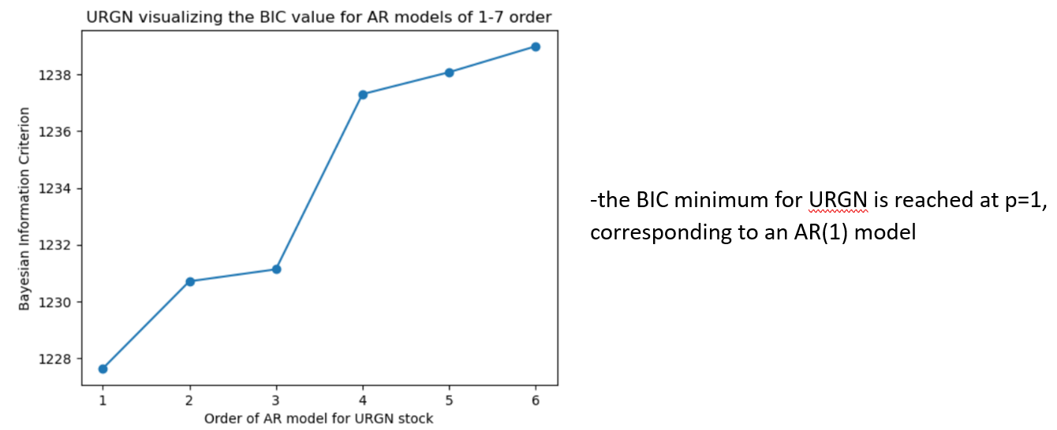
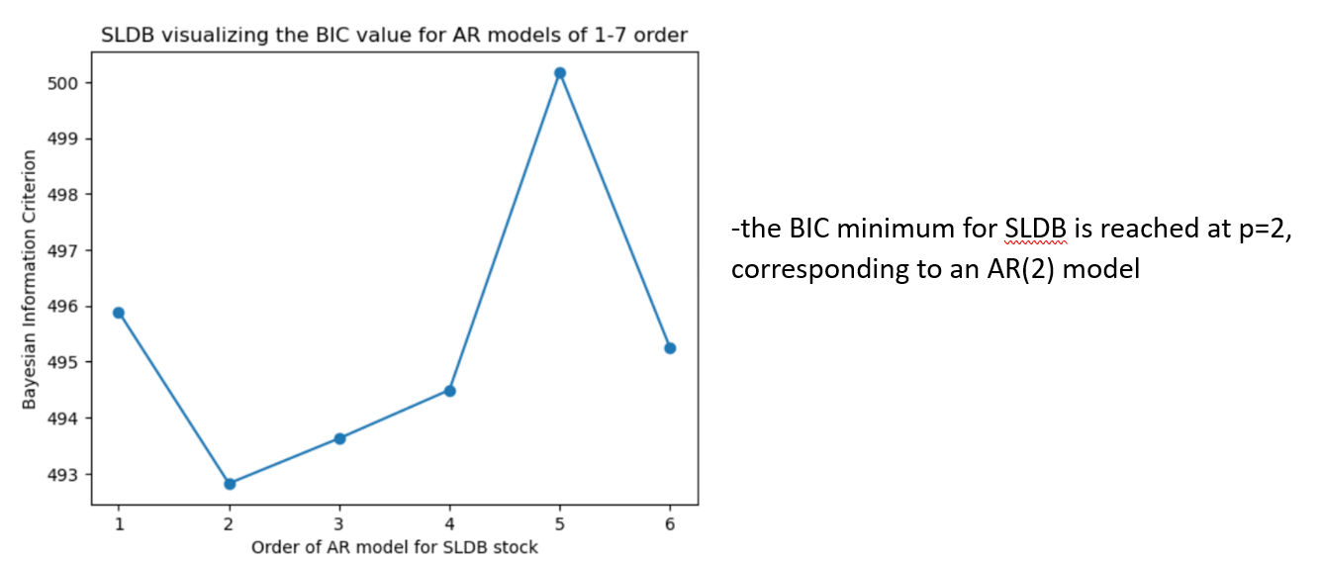
Capstone 3 – Choosing the right model
The information criteria: AIC and BIC

Slide 6
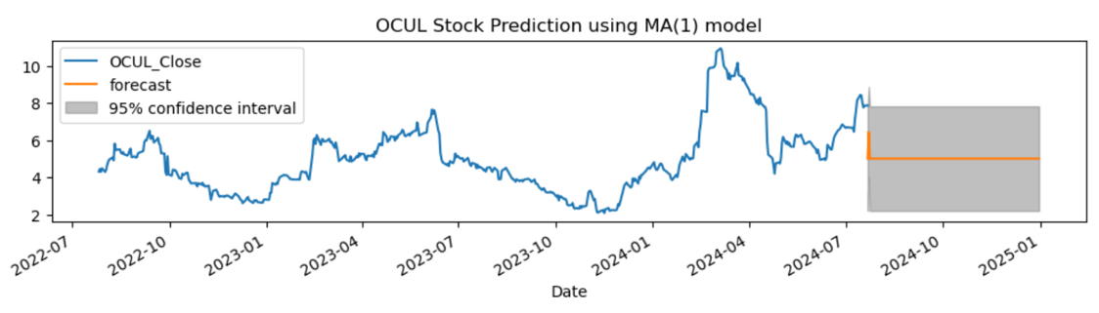
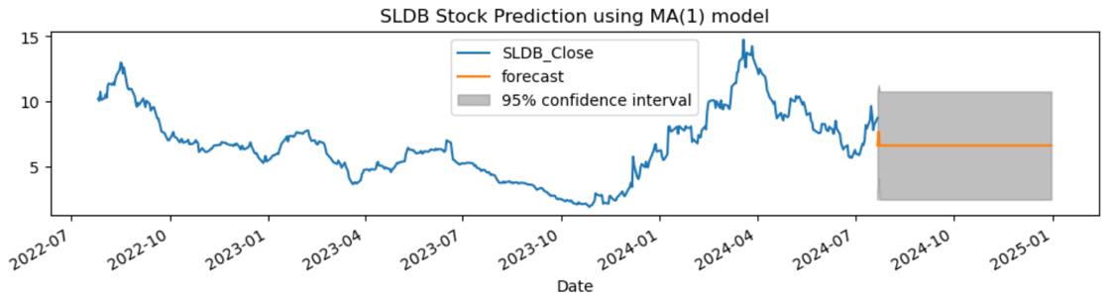
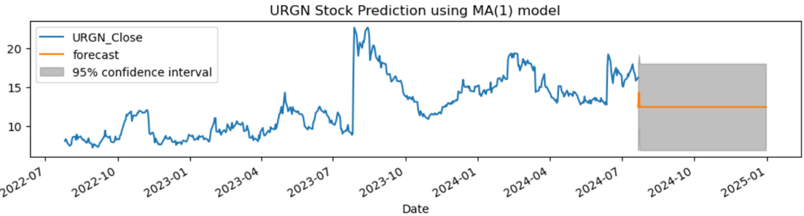
Capstone 3 – MA model forecasting
The MA model expresses the current value
of the series as a linear combination of past
error terms (or shocks).

Slide 7
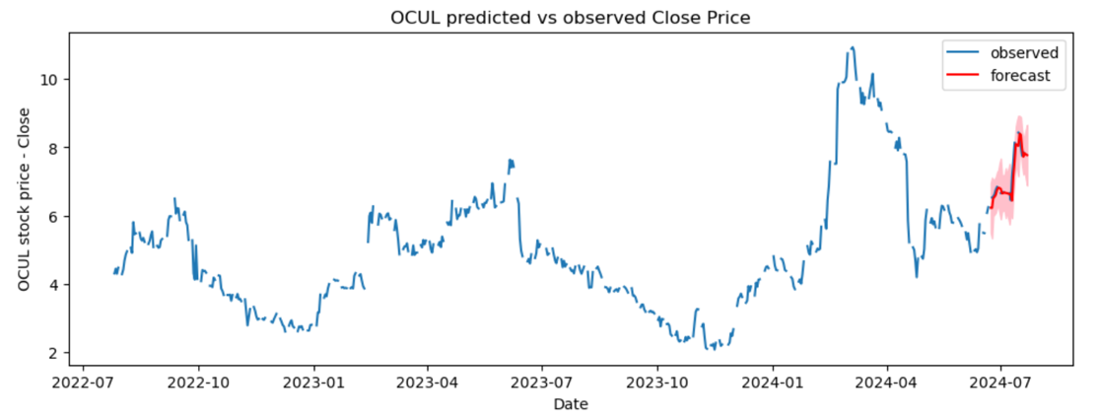
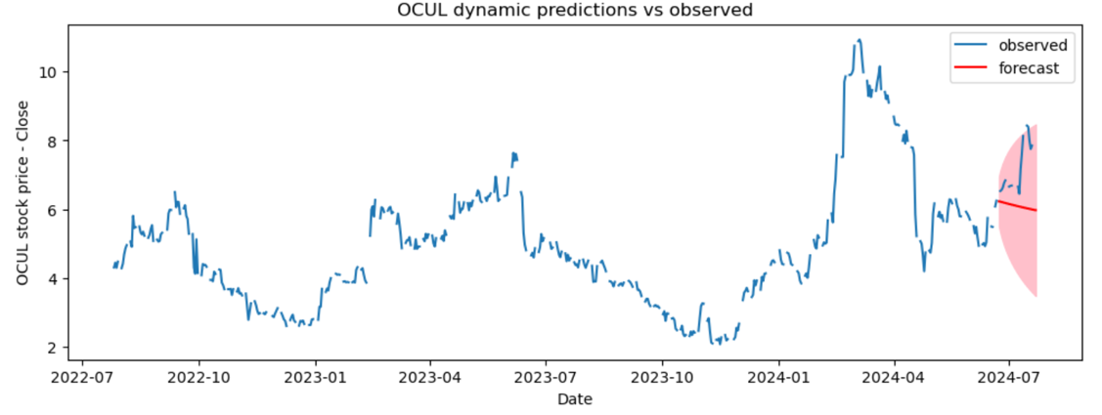
Capstone 3 – ARMA model forecasting
We set the start parameter as a negative integer stating how many steps back to begin the forecast. Setting start to -25 means we make predictions for the last 25 entries of the training data
Dynamic prediction with ARMA (Autoregressive Moving Average) models involves forecasting future values of a time series by using past values and past forecast errors

Slide 8
Capstone 3 – model metrics
Fit ARIMA Model On OCUL Daily Data
Scenario 1: Make daily predictions for last 20 values
Scenario 2: Make dynamic daily predictions for last 30 values
Scenario 3: Make weekly predictions for last 20 values
Scenario 4: Make monthly predictions for last 20 values

Slide 9
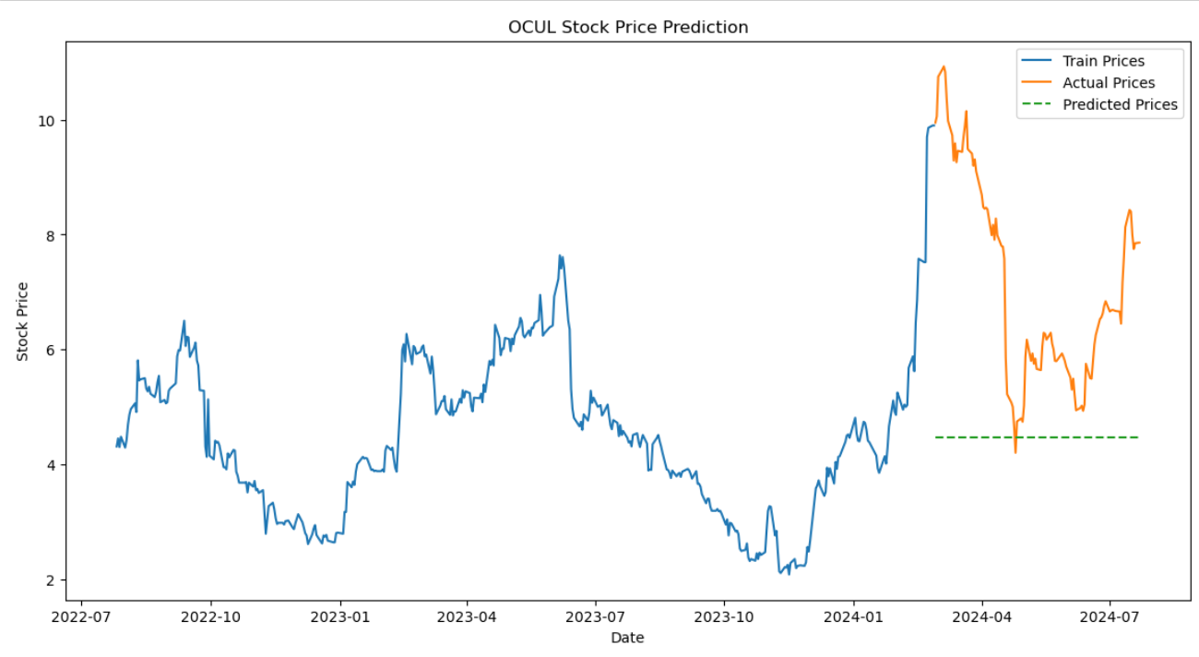
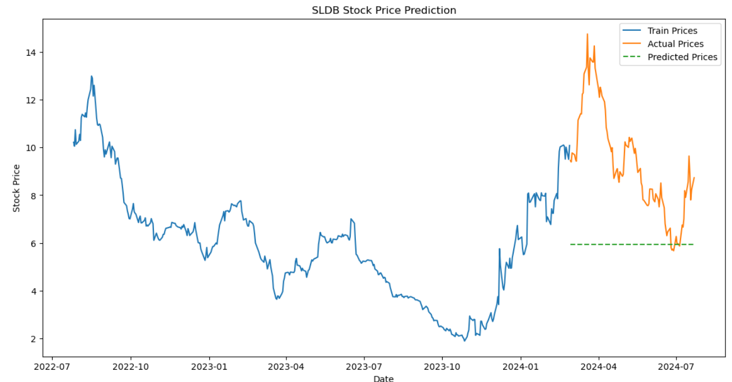
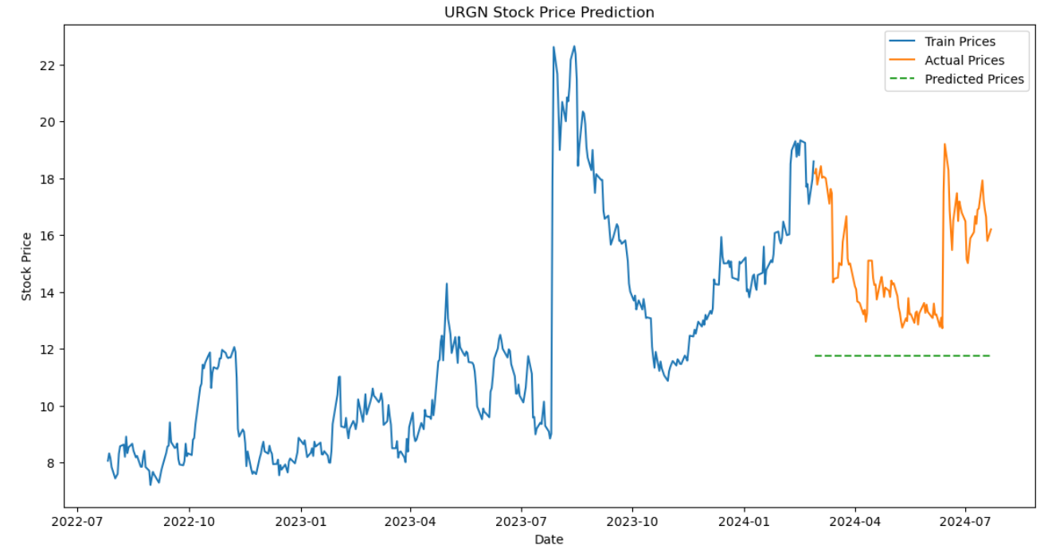
Capstone 3 – Dummy regressor

Slide 10
Capstone 3 – Dummy regressor
Metrics
Evaluation results for OCUL:
MAE = 2.710534214391601, RMSE = 3.2431841595016793
Evaluation results for SLDB:
MAE = 3.4618874827669996, RMSE = 4.078958714150425
Evaluation results for URGN:
MAE = 3.285825030912499, RMSE = 3.736536646951657

Slide 11
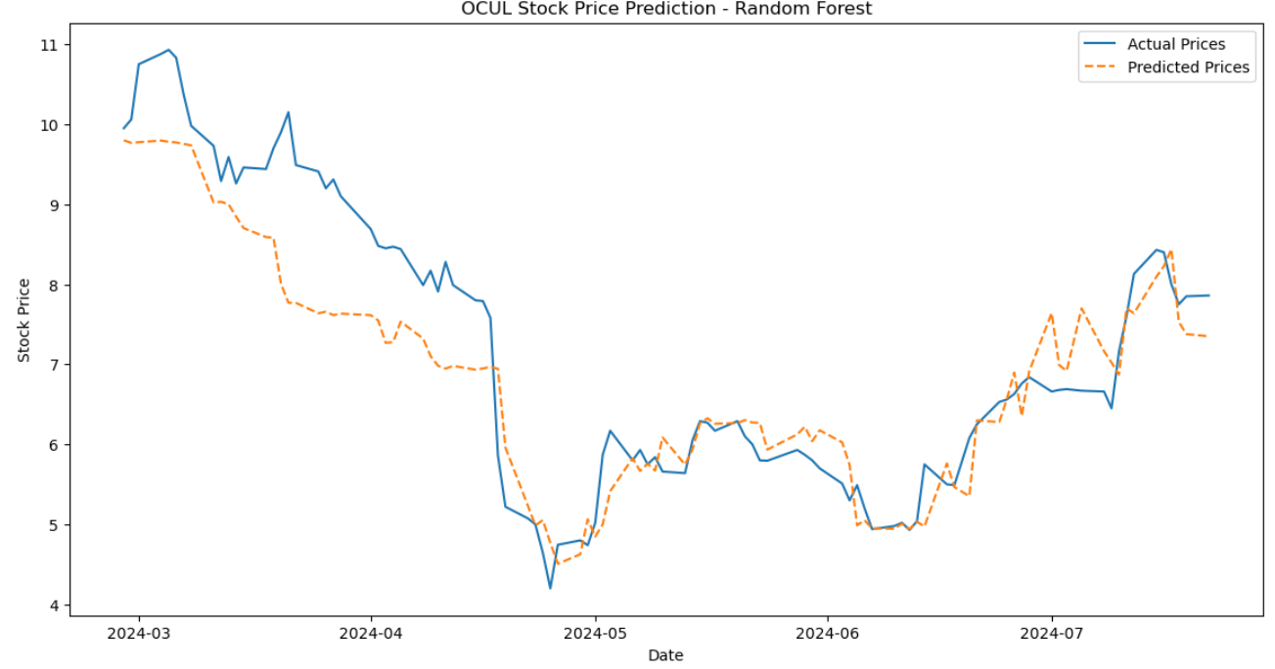
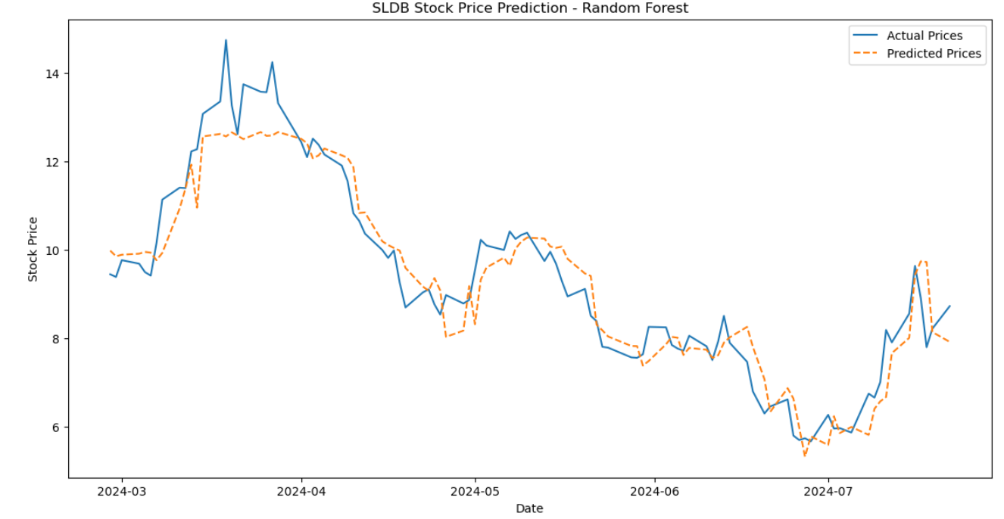
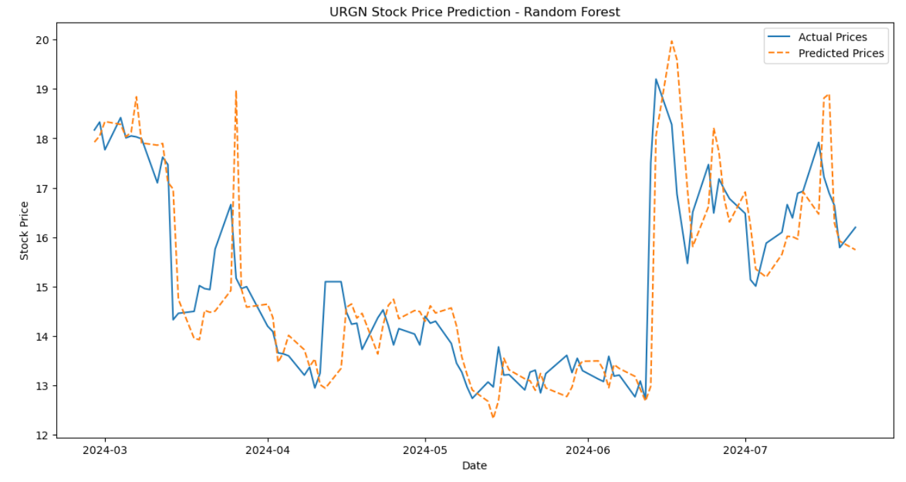
Capstone 3 – Random Forest and Decision Tree ML models

Slide 12
Capstone 3 – Random Forest and Decision Tree ML models
Evaluation results for OCUL:
Decision Tree: MAE = 0.8647000407499997, RMSE = 1.1875352664402687
Random Forest: MAE = 0.5567745286040973, RMSE = 0.7439513192702546
Evaluation results for SLDB:
Decision Tree: MAE = 0.6560499993200001, RMSE = 0.8287953677408658
Random Forest: MAE = 0.5063575059780991, RMSE = 0.6573426125752424
Evaluation results for URGN:
Decision Tree: MAE = 0.8389999687, RMSE = 1.2386540663576158
Random Forest: MAE = 0.6557249682400004, RMSE = 0.9956472959620062

Slide 13
Capstone 3 – Stock price prediction
Models for OCUL /Metric | ARIMA daily | ARIMA weekly | ARIMA monthly | Dummy R | Random Forest | Decision Tree
MAE | 0.18 | 0.50 | 1.28 | 2.71 | 0.55 | 0.86
The best model corresponds to lowest MAE, which is ARIMA, on a daily frequency, MAE = 0.18

